Slide 1
Fuzzy Systems and Applications

Slide 2
CONTENTS
History Of Fuzzy Theory
Types of Uncertainty and the Modeling of Uncertainty
Probability and Uncertainty
Fuzzy Set Theory
Fuzziness versus probability
Fuzzy Logic Control (FLC)

Slide 3

History, State of the Art, and Future Development
1965 Seminal Paper “Fuzzy Logic” by Prof. Lotfi Zadeh, Faculty in Electrical Engineering, U.C. Berkeley, Sets the Foundation of the “Fuzzy Set Theory”
1970 First Application of Fuzzy Logic in Control Engineering (Europe)
1975 Introduction of Fuzzy Logic in Japan
1980 Empirical Verification of Fuzzy Logic in Europe
1985 Broad Application of Fuzzy Logic in Japan
1990 Broad Application of Fuzzy Logic in Europe
1995 Broad Application of Fuzzy Logic in the U.S.
2000 Fuzzy Logic Becomes a Standard Technology and Is Also Applied in Data and Sensor Signal Analysis. Application of Fuzzy Logic in Business and Finance.
Today, Fuzzy Logic Has Already Become the Standard Technique for Multi-Variable Control !
Sde <number>

Slide 4

Types of Uncertainty and the Modeling of Uncertainty
Stochastic Uncertainty:
The Probability of Hitting the Target Is 0.8
Lexical Uncertainty:
"Tall Men", "Hot Days", or "Stable Currencies"
We Will Probably Have a Successful Business Year.
The Experience of Expert A Shows That B Is Likely to Occur. However, Expert C Is Convinced This Is Not True.
Most Words and Evaluations We Use in Our Daily Reasoning Are Not Clearly Defined in a Mathematical Manner. This Allows Humans to Reason on an Abstract Level!
Slide <number>

Slide 5

Probability and Uncertainty
“... a person suffering from hepatitis shows in 60% of all cases a strong fever, in 45% of all cases yellowish colored skin, and in 30% of all cases suffers from nausea ...”
Stochastics and Fuzzy Logic Complement Each Other !
Slide <number>

Slide 6
Fuzzy Set Theory
Conventional (Boolean) Set Theory:
38.7°C
38°C
40.1°C
41.4°C
42°C
Fuzzy Set Theory:
39.3°C
“Strong Fever”
38.7°C
37.2°C
38°C
40.1°C
41.4°C
42°C
39.3°C
“Strong Fever”
“More-or-Less” Rather Than “Either-Or” !
37.2°C
Slide <number>

Slide 7
Fuzzy Sets...
Representing crisp and fuzzy sets as subsets of a domain (universe) U".

Slide 8
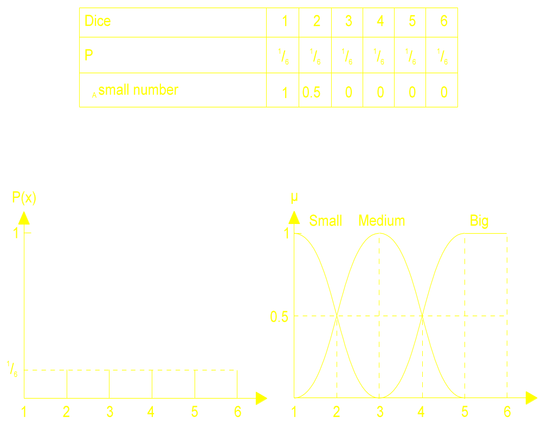
Fuzziness versus probability
Probability density function for throwing a dice and the membership functions of the concepts "Small" number, "Medium", "Big".

Slide 9
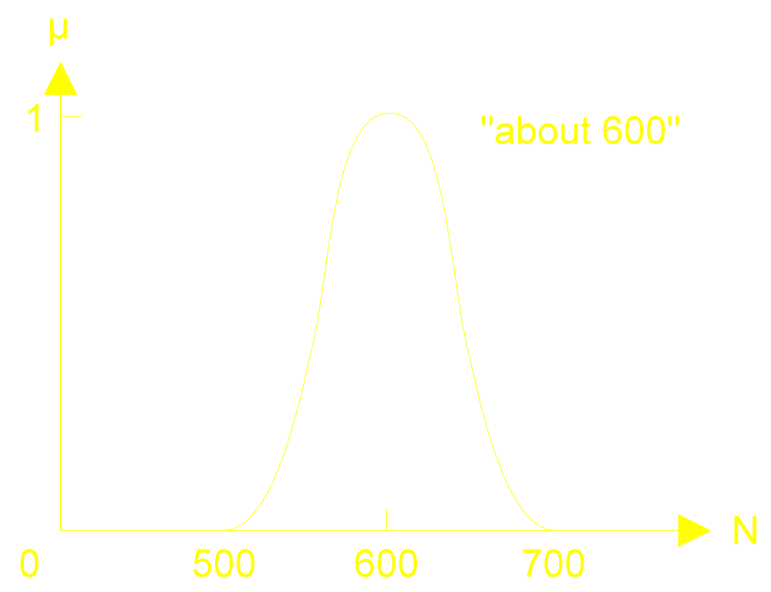
Conceptualising in fuzzy terms...
One representation for the fuzzy number "about 600".

Slide 10
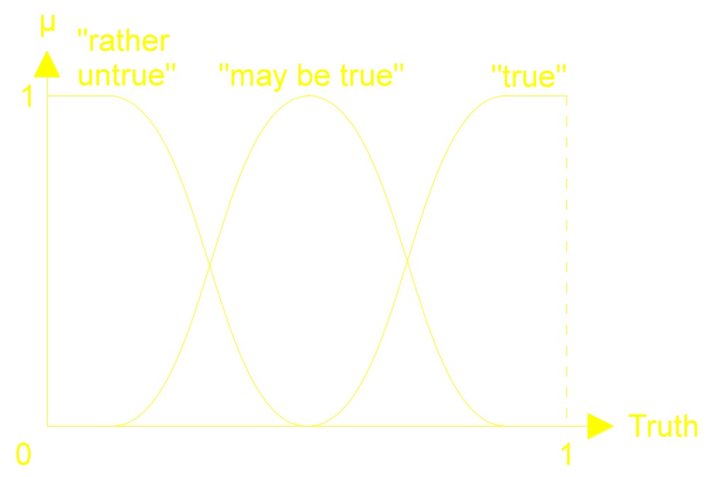
Conceptualising in fuzzy terms...
Representing truthfulness (certainty) of events as fuzzy sets over the [0,1] domain.

Slide 11
Strong Fever Revisited
Conventional (Boolean) Set Theory:
38.7°C
38°C
40.1°C
41.4°C
42°C
Fuzzy Set Theory:
39.3°C
“Strong Fever”
38.7°C
37.2°C
38°C
40.1°C
41.4°C
42°C
39.3°C
“Strong Fever”
37.2°C
Slide <number>

Slide 12

Fuzzy Set Definitions
Discrete Definition:
µ_{SF}(35°C) = 0 µ_{SF}(38°C) = 0.1 µ_{SF}(41°C) = 0.9
µ_{SF}(36°C) = 0 µ_{SF}(39°C) = 0.35 µ_{SF}(42°C) = 1
µ_{SF}(37°C) = 0 µ_{SF}(40°C) = 0.65 µ_{SF}(43°C) = 1
Continuous Definition:
No More Artificial Thresholds!
Slide <number>

Slide 13
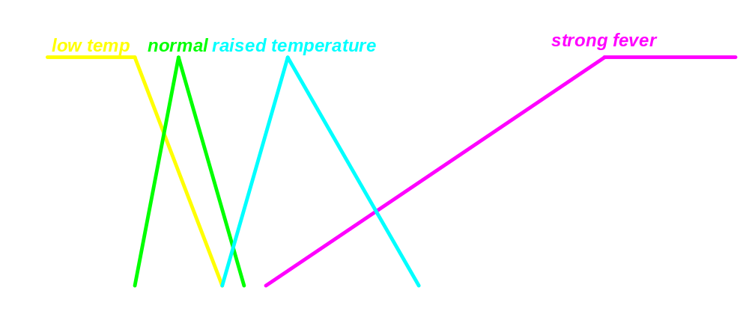
Linguistic Variable
...Terms, Degree of Membership, Membership Function, Base Variable...
… pretty much raised …
A Linguistic Variable Defines a Concept of Our Everyday Language!
... but just slightly strong …
Slide <number>

Slide 14
Fuzzy Logic Control (FLC)

Slide 15
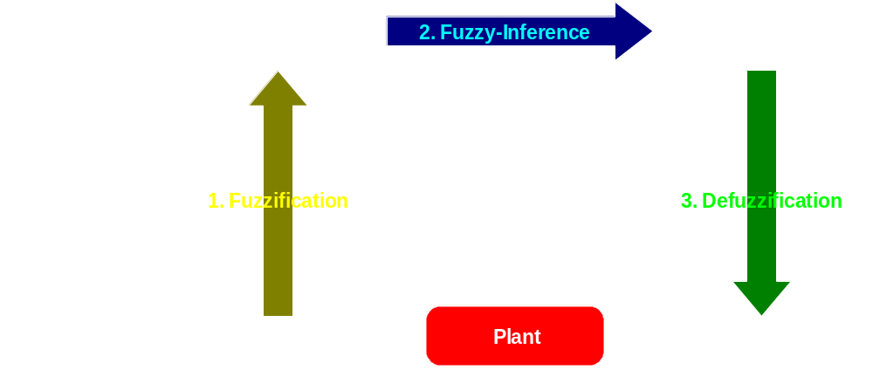
Basic Elements of a
Fuzzy Logic System
Fuzzy Logic Defines the Control Strategy on a Linguistic Level!
Fuzzification, Fuzzy Inference, Defuzzification:
© INFORM 1990-1998 Slide <number>

Slide 16

Basic Elements of a
Fuzzy Logic System
Closing the Loop With Words !
Control Loop of the Fuzzy Logic Controlled Container Crane:
© INFORM 1990-1998 Slide <number>

Slide 17
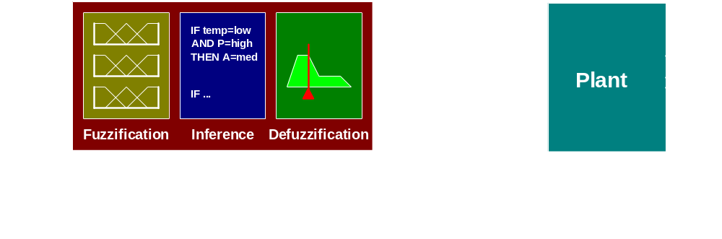
Types of Fuzzy Controllers:
- Direct Controller -
The Outputs of the Fuzzy Logic System Are the Command Variables of the Plant:
Fuzzy Rules Output Absolute Values !
© INFORM 1990-1998 Slide <number>

Slide 18
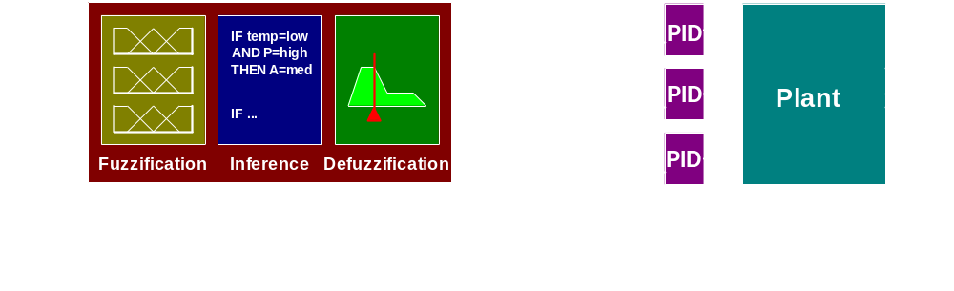
Types of Fuzzy Controllers:
- Supervisory Control -
Fuzzy Logic Controller Outputs Set Values for Underlying PID Controllers:
Human Operator Type Control !
© INFORM 1990-1998 Slide <number>

Slide 19
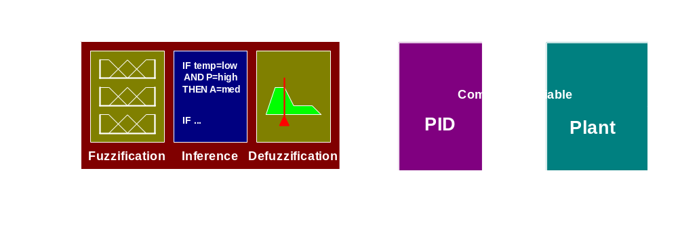
Types of Fuzzy Controllers:
- PID Adaptation -
Fuzzy Logic Controller Adapts the P, I, and D Parameter of a Conventional PID Controller:
The Fuzzy Logic System Analyzes the Performance of the PID Controller and Optimizes It !
© INFORM 1990-1998 Slide <number>

Slide 20
CONCLUSION
Non-Modeled Based Controller
Knowledge Based

Slide 21
Thank You for your attention

